Slide 1

G2M Case Study
Exploratory Data Analysis on Cab Company Investment
20-Apr-2023

Slide 2
Background –G2M(cab industry) case study
XYZ is a private firm in the US that plans to invest in the cab industry. They want to understand the market before making a final decision. As a data analyst, we conducted an exploratory data analysis using provided datasets to identify the right company for investment.
The analysis is structured into four objectives:
Data Comprehension and Explanation
Forecasting Profits and Ride Volume for Each Cab Company
Identifying the Most Profitable Cab Company
Summary and Recommending Investment Selections

Slide 3
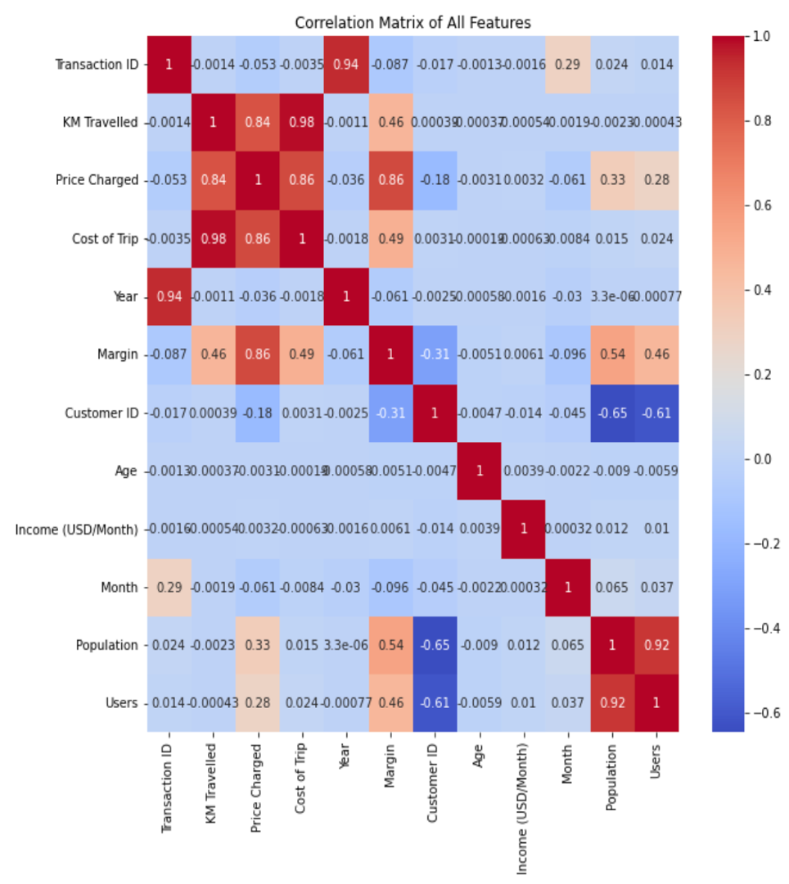
Data Exploration
We were provided with four datasets, containing transaction details, customer demographics, transaction to customer mapping and payment mode, and city population data. The time period of the data is from January 31, 2016, to December 31, 2018.
We combined four separate datasets, namely Cab_Data.csv, City.csv, Customer_ID.csv, and Transaction_ID.csv, to create the final dataset. This consolidated dataset consists of 20 features and a total of 359,391 records.
Assumptions:
Price_Charged and Cost_of_Trip features used to calculate profit (margin).
Profit is directly correlated to number of customers.
Though Customer_ID and Transcation_ID displayed in the Correlation Matrix, they were not treated as numeric features

Slide 4
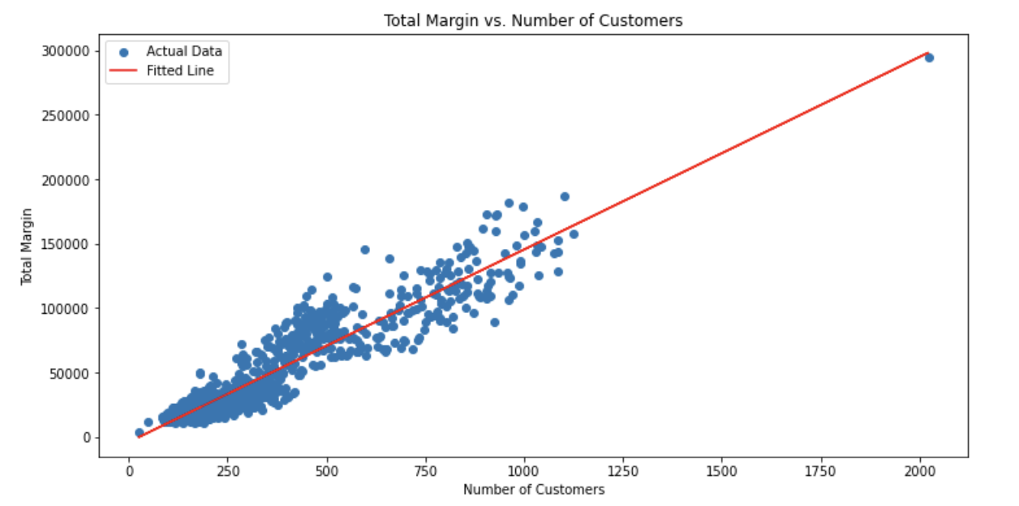
Profit Analysis
Profit to Customer Analysis
The profit of each company show strong correlation with customer number.

Slide 5
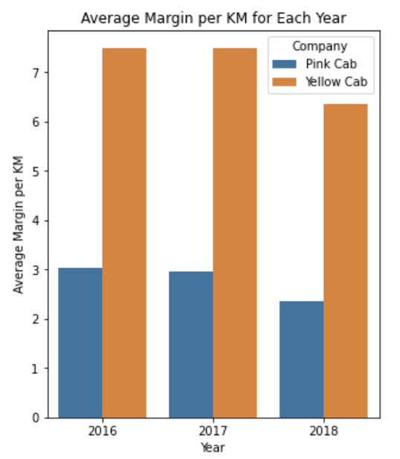
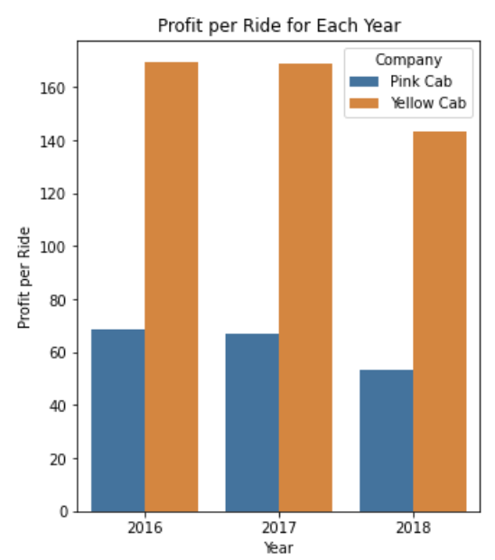
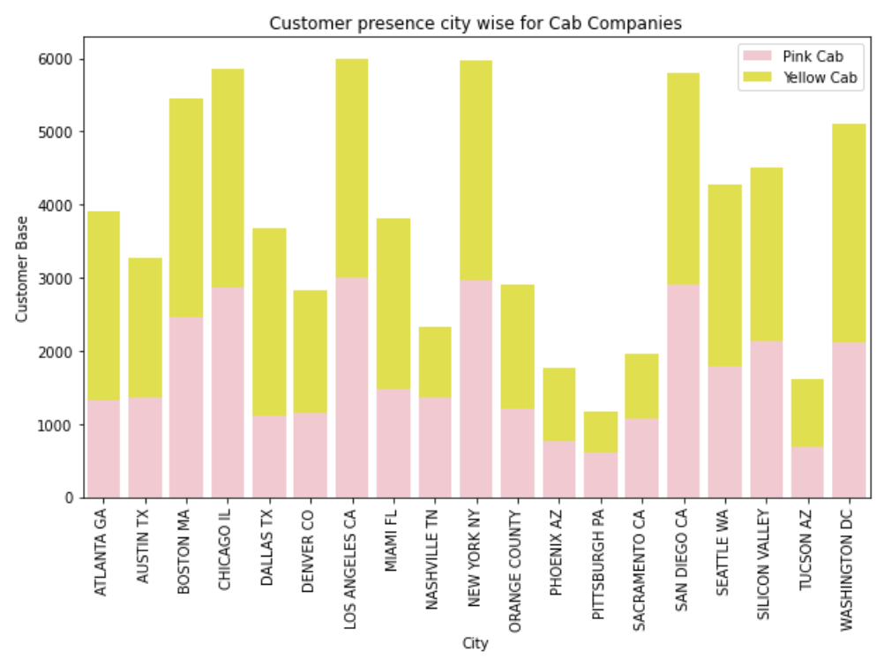
Profit Analysis
Profit Analysis
We analyzed the yearly average profit and profit per ride for both Yellow Cab and Pink Cab. Our findings show that Yellow Cab consistently generates higher yearly average profits and profits per ride compared to Pink Cab. Furthermore, in terms of city-wise customer presence, Yellow Cab emerges as the more popular choice among riders.

Slide 6
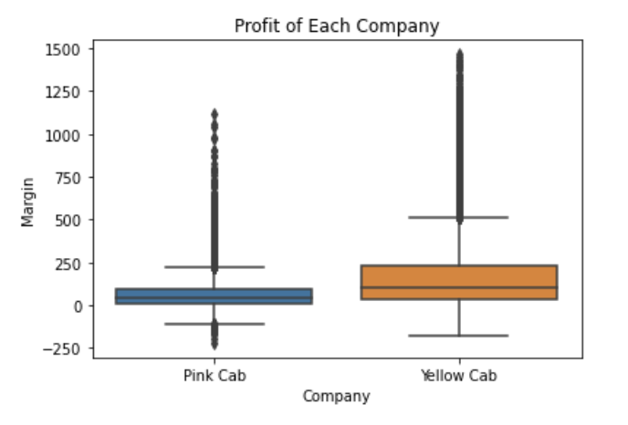
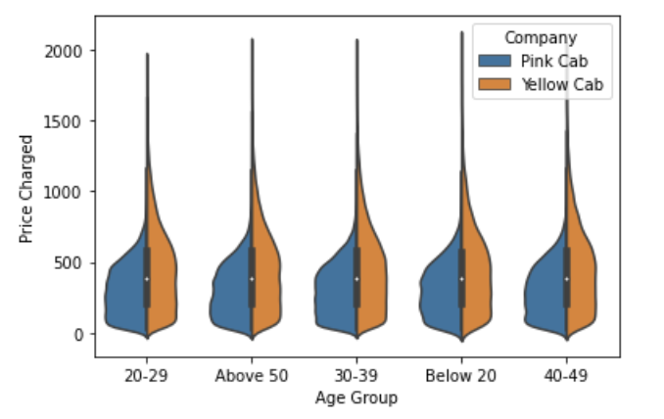
Profit Analysis
Profit Analysis

Slide 7
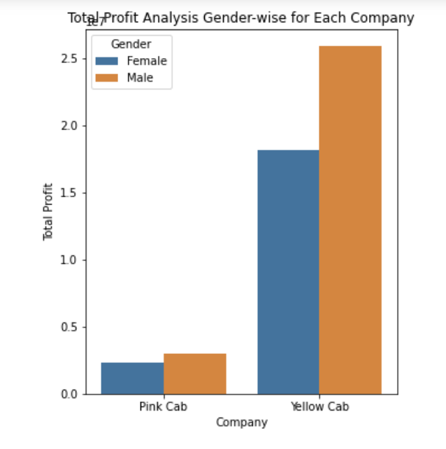
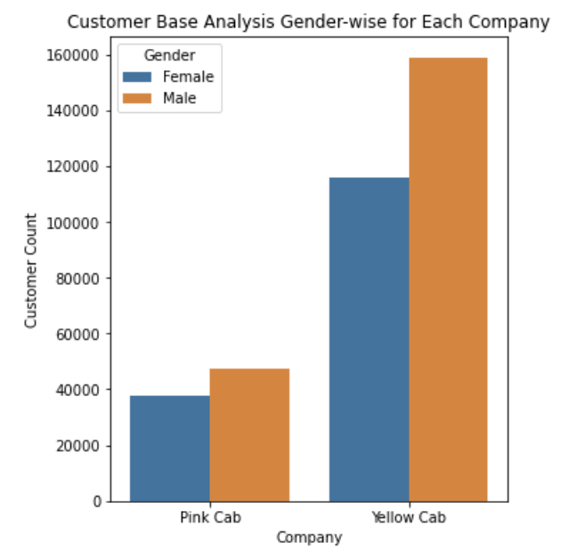
Profit and customer base Analysis Gender wise
Hypothesis 1: The cab demand and profits vary across gender groups.
Our findings reveal that both female and male customers show a preference for Yellow Cab over its competitor.

Slide 8
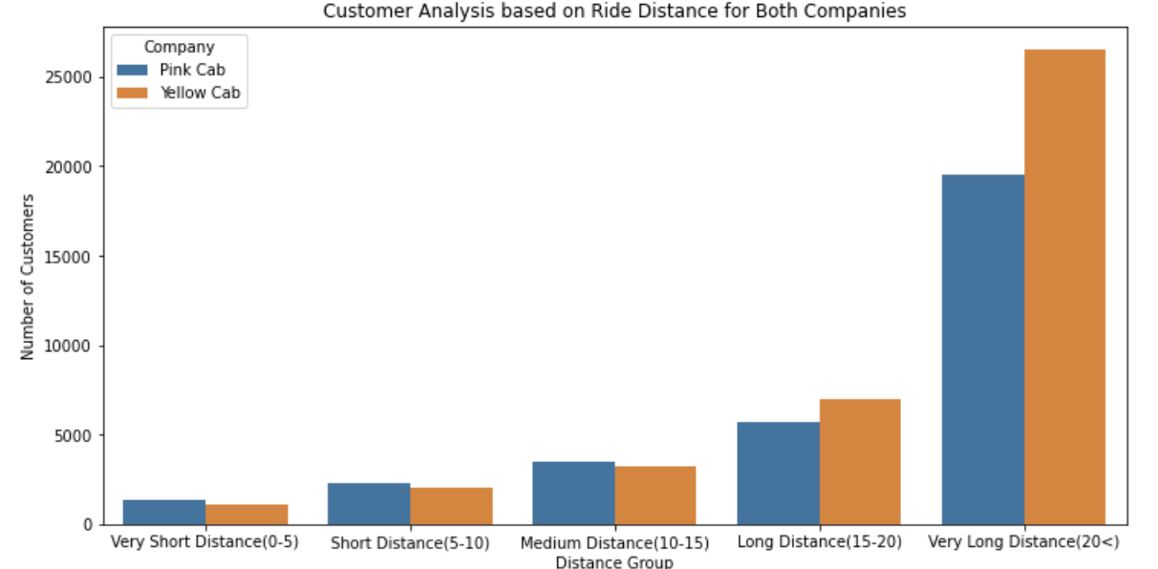
Customer base Analysis Distance wise
Hypothesis 2: The distance of ride will change the demand of Cab companies.
We found that customers prefer Pink Cab for short distance ride, Yellow Cab for long distance ride.

Slide 9
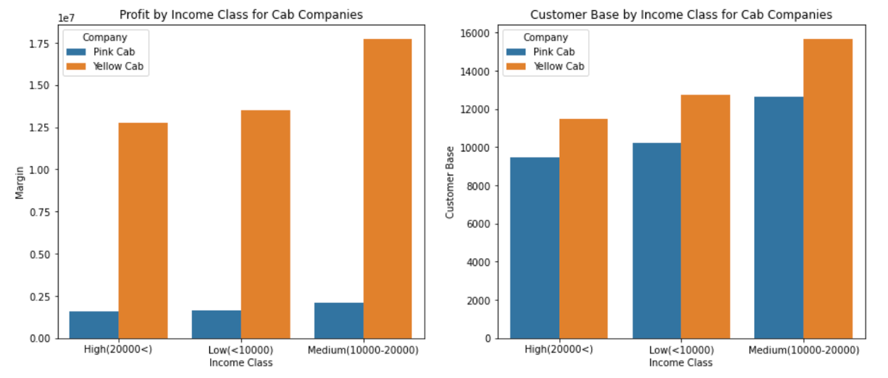
Income Class wise Profit and customer base Analysis
Hypothesis 3: The cab demand and profits vary across income classes.
Customers across all income classes tend to prefer Yellow Cab over Pink Cab. Notably, the high-income segment contributes significantly to Yellow Cab's higher profits.

Slide 10
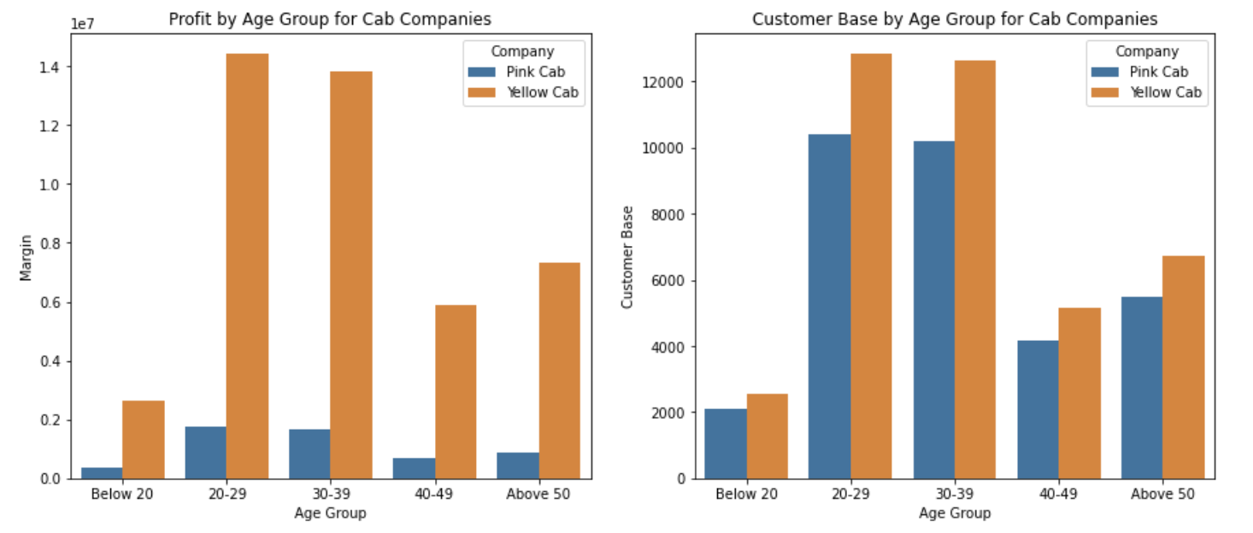
Age GroupWise Profit And Customer Base Analysis
Hypothesis 4: The cab demand and profits vary across age groups.
Customers across all age groups tend to prefer Yellow Cab over Pink Cab.

Slide 11
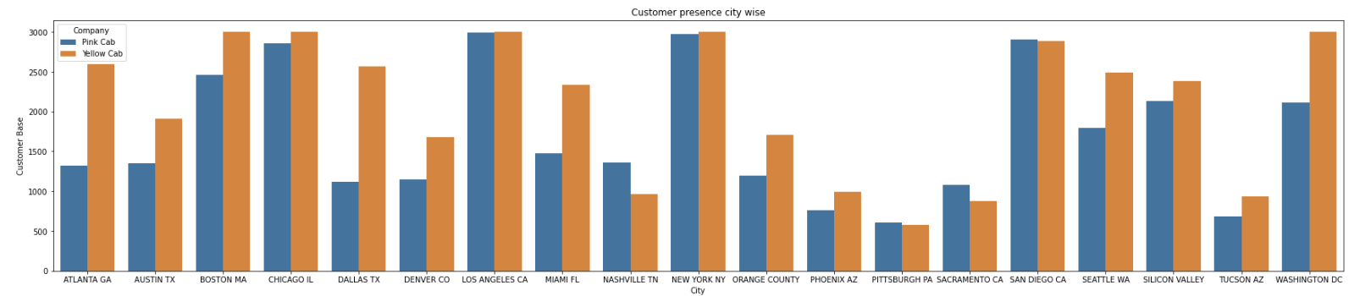
Customer Presence of Yellow and Pink cab city wise
Hypothesis 5: Customers in different cities have different preference of cab companies.
In nearly all the cities featured in the dataset, Yellow Cab emerged as the preferred choice, with the exception of San Diego, Nashville, Sacramento, and Pittsburgh.

Slide 12
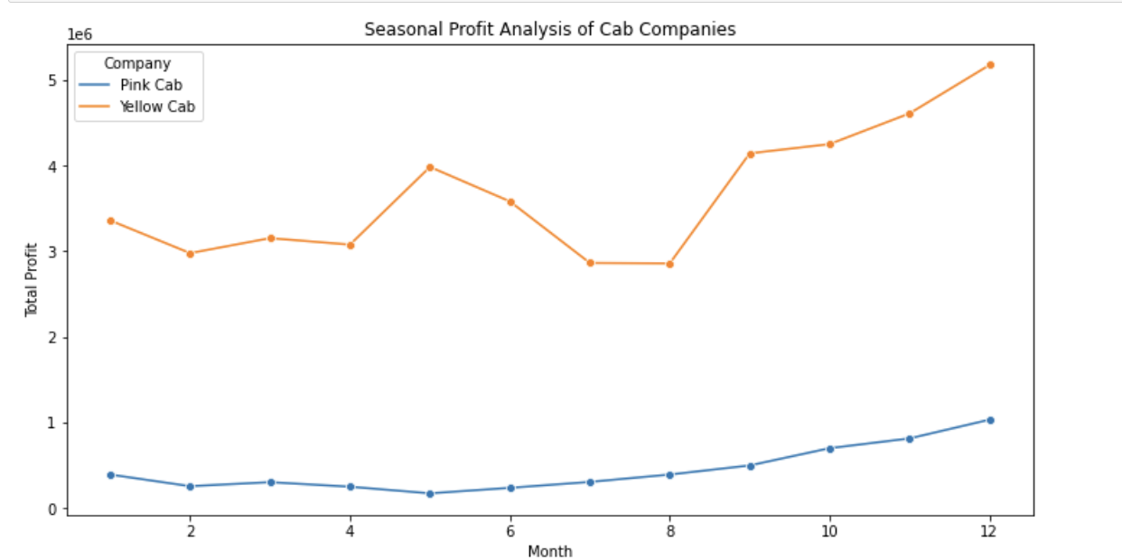
Seasonality in the demand
Hypothesis 6: The cab demand and usage patterns for both companies vary across different months
The seasonal component influences profits, with lower earnings observed from January to April and from July to August. Despite these fluctuations, Yellow Cab consistently maintains a higher overall profit compared to Pink Cab.

Slide 13
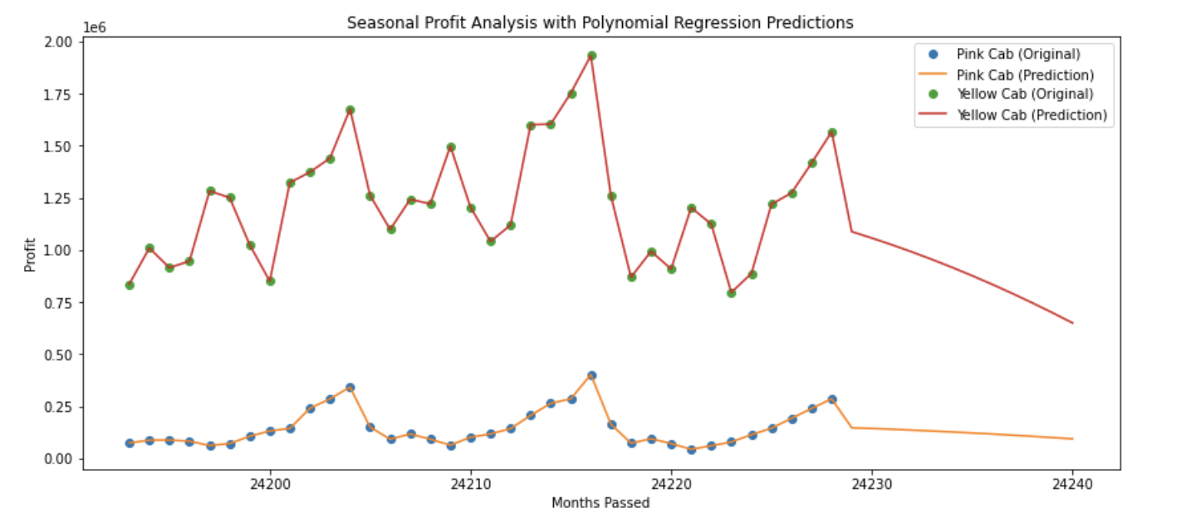
Seasonality in the demand
This is a polynomial prediction of the profit for the next 12 months.

Slide 14
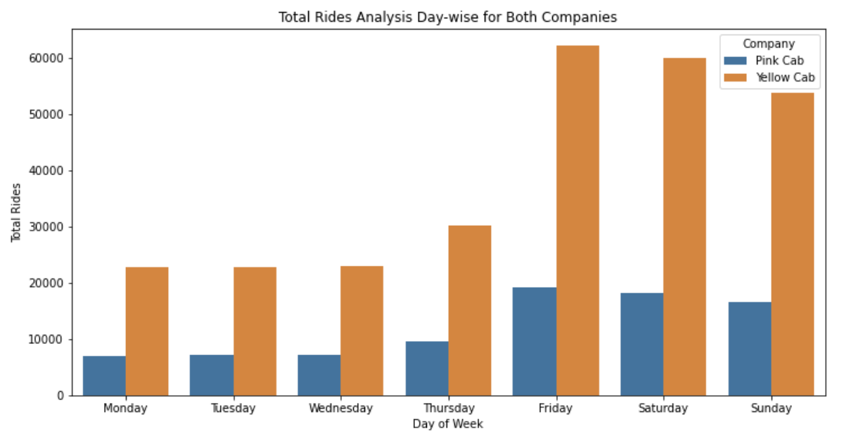
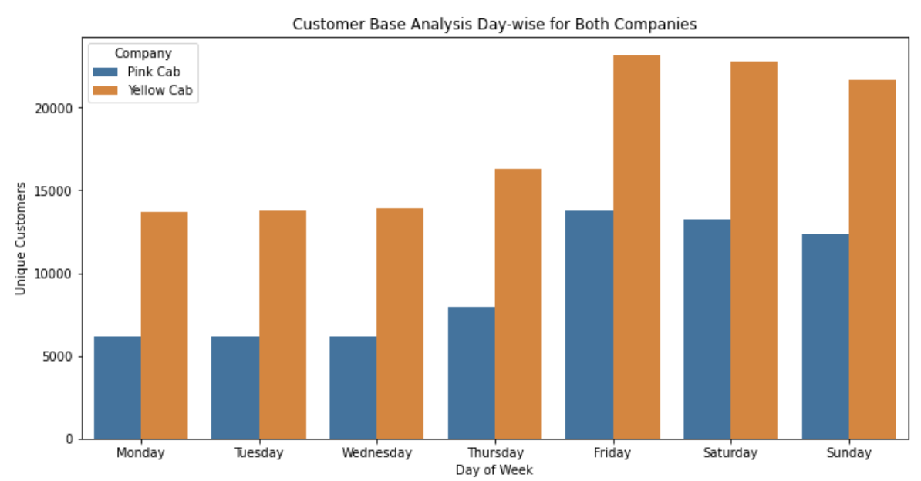
Customer And Ride Analysis Day Wise
Hypothesis 7: The cab demand and usage patterns for both companies vary across different days of the week
During both weekdays and weekends, Yellow Cab consistently generates higher profits and attracts a larger customer base compared to Pink Cab.

Slide 15
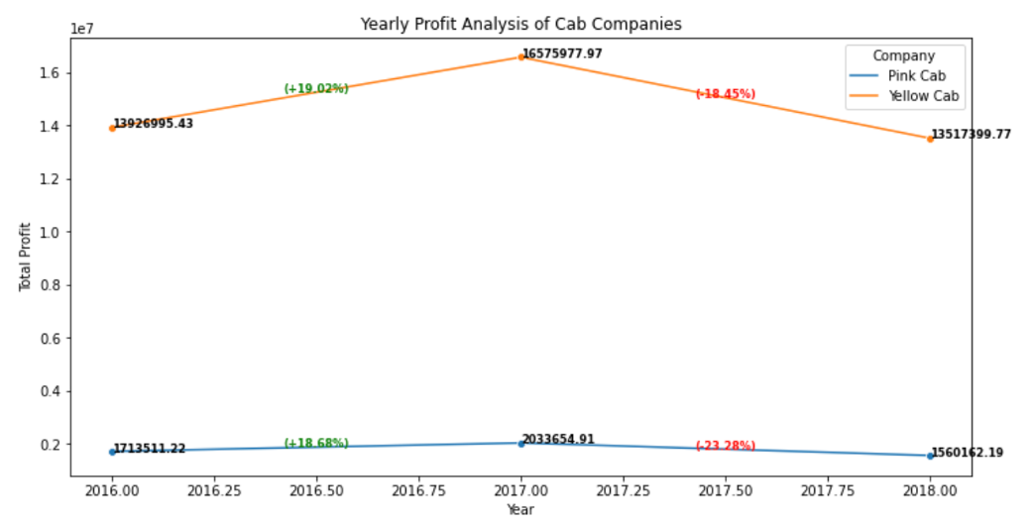
Yearly Profit Analysis

Slide 16
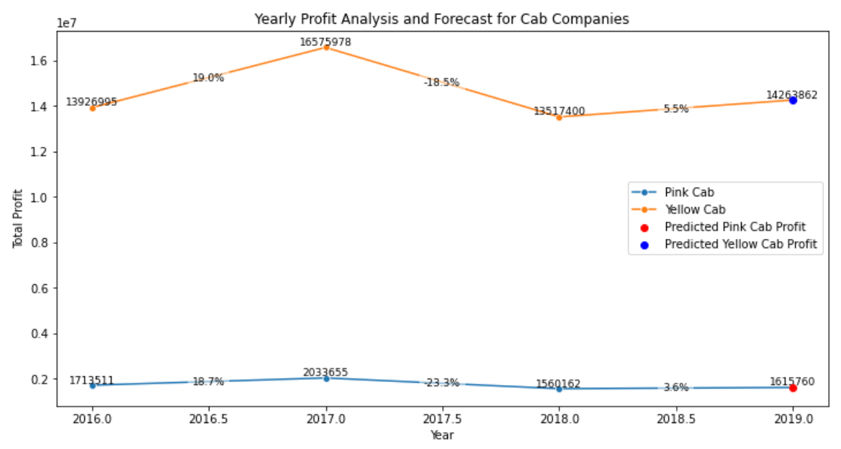
Yearly Profit Prediction

Slide 17

Recommendations
We recommend Yellow Can for investment based on following reasons:
Customer Presence: Yellow Cab is the preferred choice in a majority of cities in our dataset compared to Pink Cab, ensuring a more promising customer base.
Age wise Reach : Yellow Cab has a considerably larger customer base across all age groups compared to Pink Cab.
Average Profit per KM:Yellow Cab generates significantly higher profit per KM.
Income wise Reach : Yellow Cab is more popular among all income classes and is particularly profitable within the high-income segment.
Ride count and Profit Forecasting : As predicted by our linear regression model, the profit growth for Yellow Cab in the next year is estimated to be 5.5%, while Pink Cab is projected to grow at 3.6%.
Based on these factors, we recommend investing in Yellow Cab.

Slide 18
Thank You

